Slide 1


Slide 2


Heart quiz!
Q1. What is the main purpose of the heart?
A1. To pump blood around your body
Q2. Does your heart have 3,4 or 5 chambers?
A2. Four
Q3. Does the average adult heart beat around 50,000, 75,000 or 100,000 times a day?
A3. 100,000 times

Slide 3
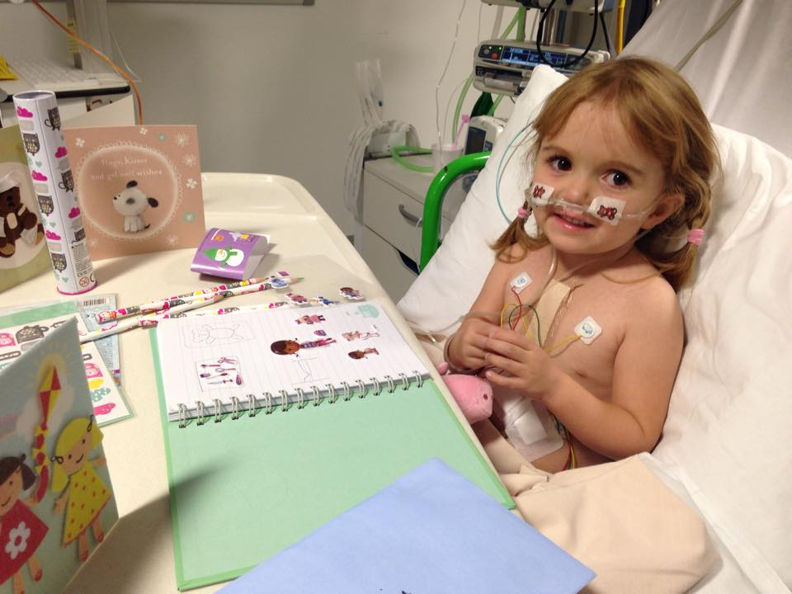
[CHILD’S NAME]’s story
Notes:
THIS IS ENTIRELY UP TO YOU WHETHER YOU FEATURE THIS SLIDE – DELETE IF YOU WISH!
Keep this relatively short and stick to the basics. When did you find out? What difference has it made to your lives?
Explain your feelings
Add your own photo and bullet point if you wish

Slide 4

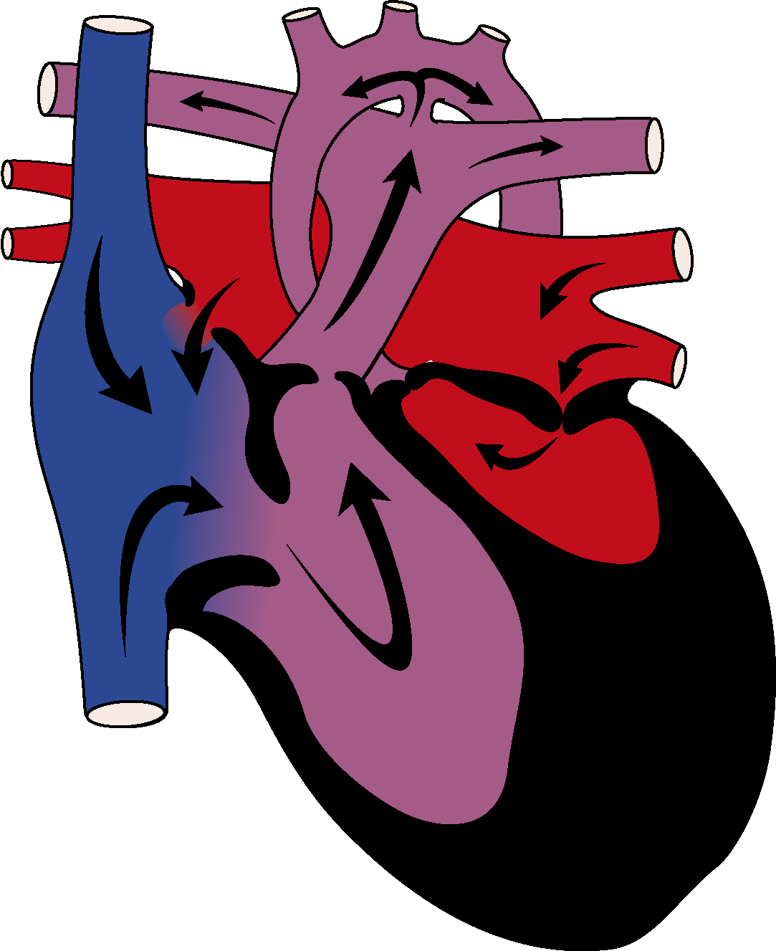
Can you play ‘spot the difference’?
The Normal Heart
Hypoplastic Left Heart Syndrome
Notes:
Don’t spend too long on this and don’t worry if you can’t explain all the differences, it’s more just to show that there are differences between a Single Ventricle Heart and a “normal” heart

Slide 5
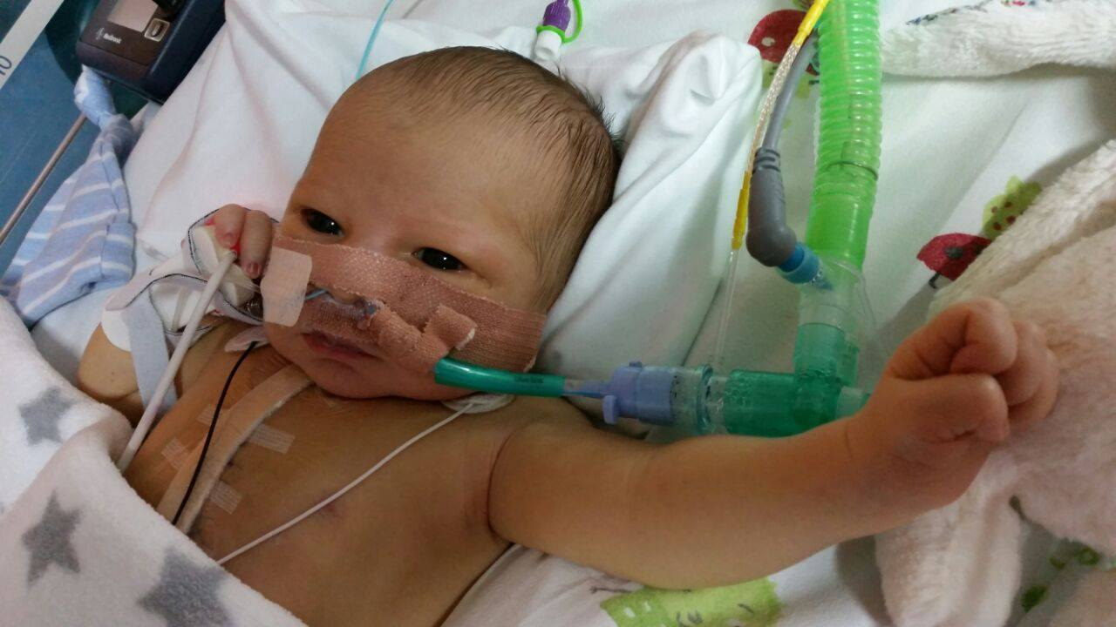
What happens when a baby with half a heart is born?
Children like (NAME) have to have their first operation in the first few days of their life.
Then they need another operation when they are 6 months old.

Slide 6
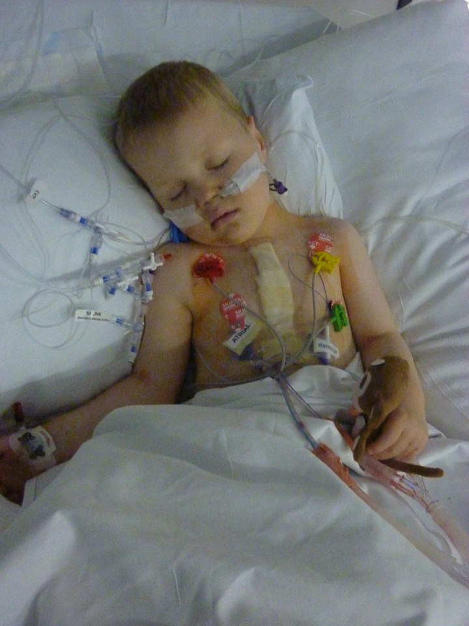
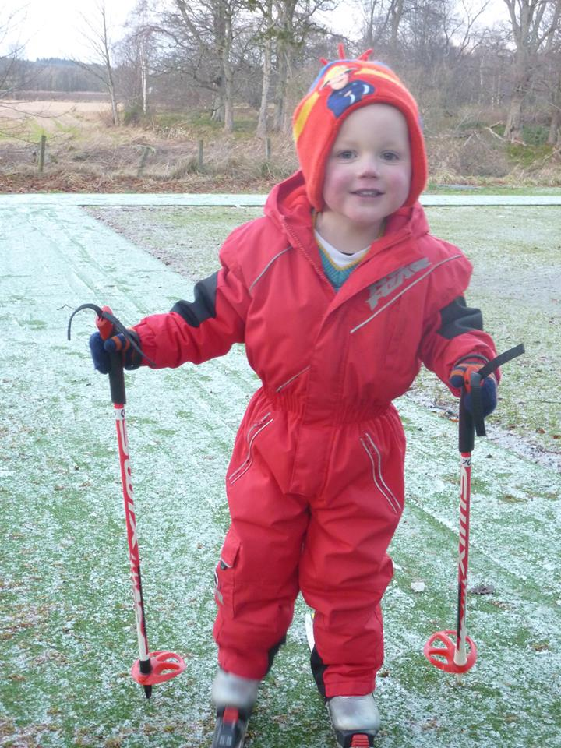
What happens when the child gets older?
Between the ages of 3 and 6 there’s yet another operation.
This is called the Fontan operation.
It’s a big operation, but it does help the child cope better with the condition.

Slide 7
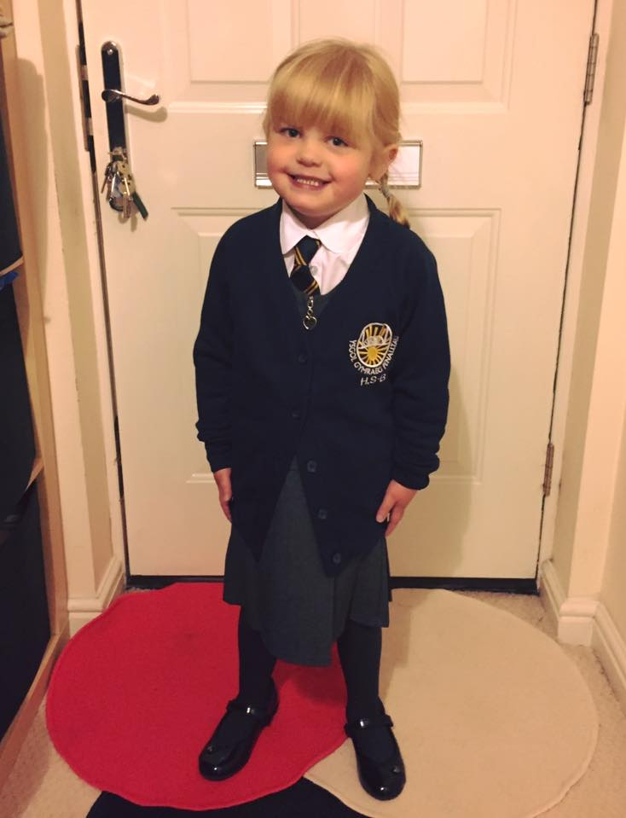
What does having half a heart mean for the child?
Feel tired a lot of the time.
Always visiting hospital.
Lots of time off school.
Worry for child, parents, family/ friends.
Can’t eat the same things as everyone else.
Feel cold.
Blue lips.
Can’t keep up.

Slide 8
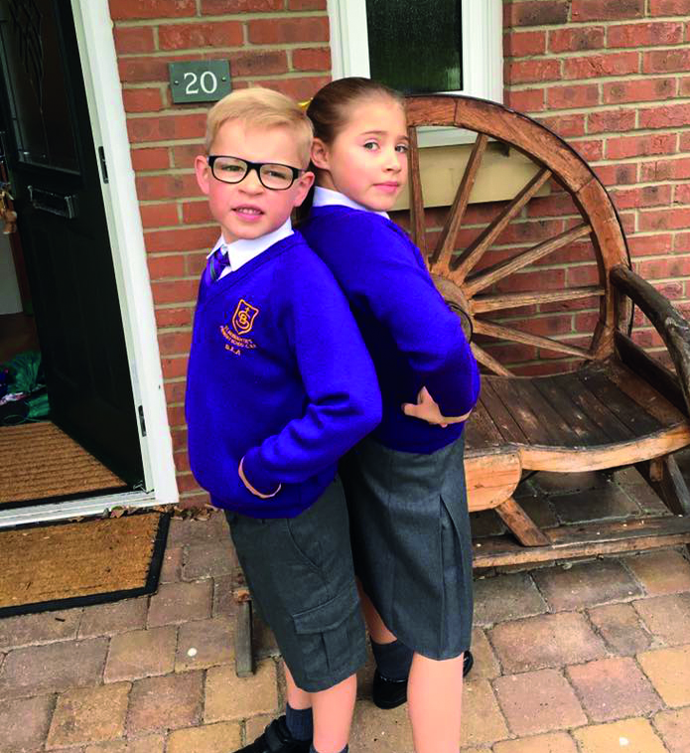
What does it mean for the child at school?
Low on energy.
Hard to concentrate.
Miss classes.
Miss tests and exams.
Can’t do as much physical exercise.

Slide 9
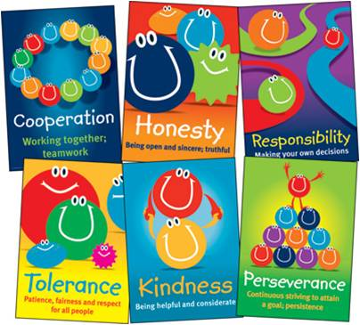
What you can do to help
Think about what your school values are and show:
Respect.
Responsibility.
Tolerance.
Thoughtfulness.
Friendship.
Courage.
Appreciation.
Notes:
If you can ask about, find and match the school you’re presenting to values to this slide then that’d be preferable
If you want to remove this slide, that’s fine, but does link to the school well

Slide 10

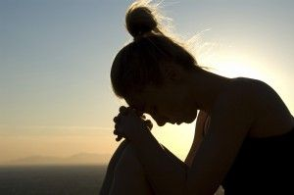


Little Hearts Matter
Help to reduce:
Fear
Isolation
Lack of understanding
Notes:
Explain briefly how you felt before LHM and how LHM has helped you and your family

Slide 11


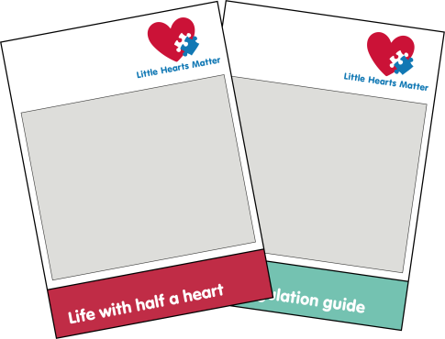
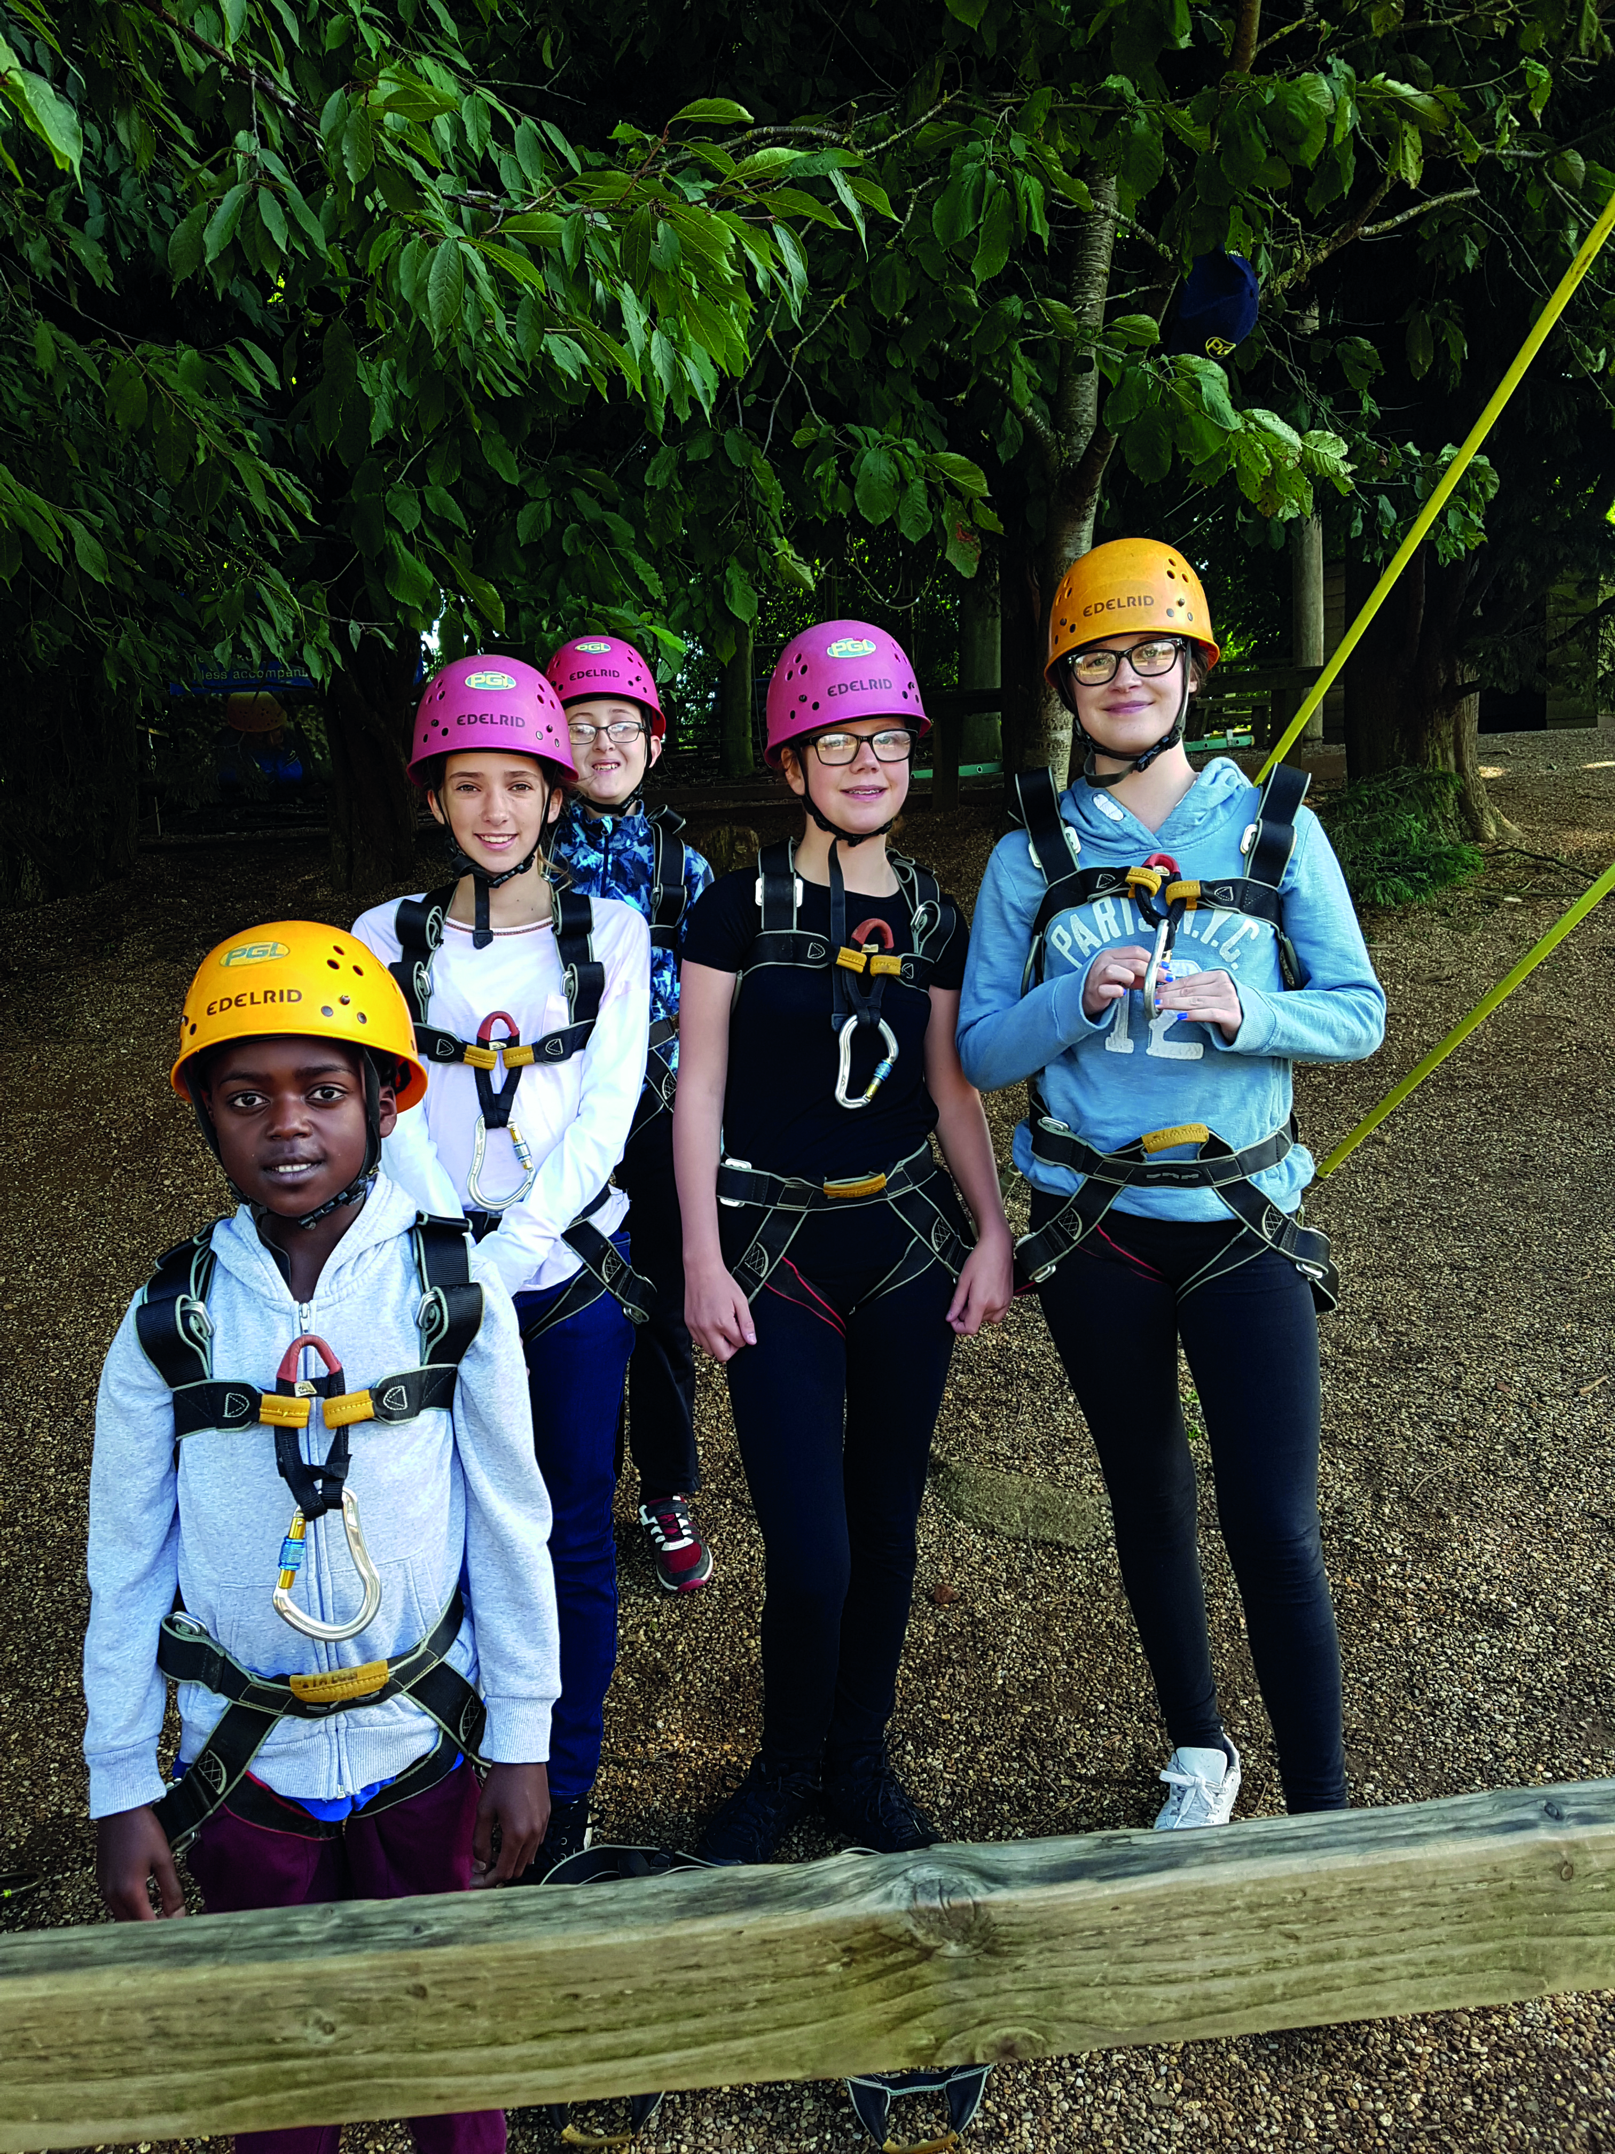
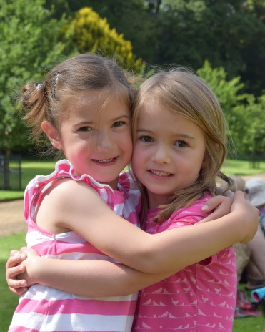
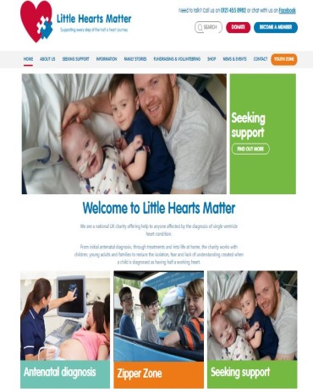
Little Hearts Matter provide
Phone line
Social media
Information
Events
Friendships
Website
Notes:
Don’t need to go into too much detail, just shows children where any money raised would go

Slide 12
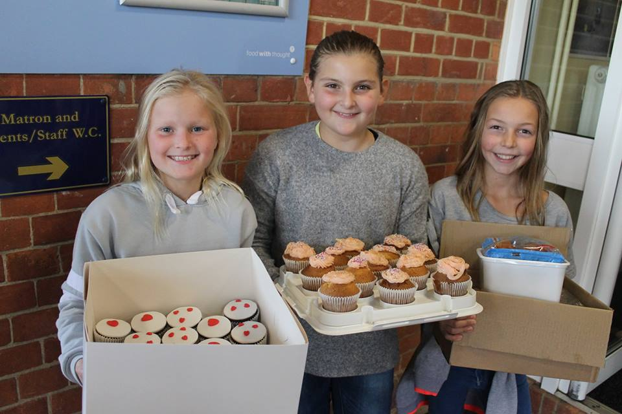
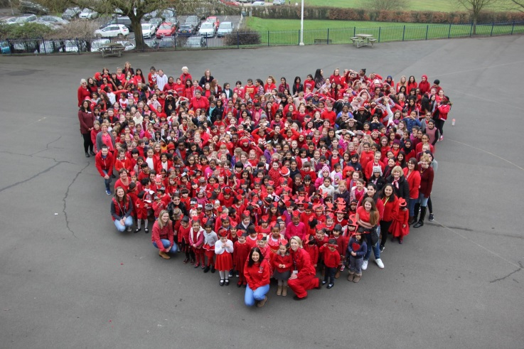
Fundraising for Little Hearts Matter
LHM needs money to provide these much needed services.
It’s up to you what you can do:
Dress down days/half dress down days.
Christmas/summer fair stall.
Competitions.
Sponsored challenges (runs, walks, silences).
Notes:
Find out whether there’s a school council and mention this if possible, but try and sell just how much their fundraising will help!

Slide 13
